Slide 1
How learning skateboard tricks is just like learning physics
(or math, piano, engineering, ...)
After exam-- trying to master new trick (double kickflip?)
beyond level of competence, but not impossibly so--attainable
try with full focus- when fail, analyze why.
modify what did and try again. (“deliberate”)
when succeed, analyze how made changes to achieve.
repeat until reasonably easy
then try harder trick--
repeat and repeat. After hundreds-thousands of hours, get really expert.
classic pattern of “deliberate practice”-- how all experts
become expert. See new posting on website “The influence of experience and deliberate practice on the development of superior expert performance” K. Anders Ericsson

Slide 2
panic
learning
Example of how to become expert in physics
(also practiced by some of you)
routine
try to see how can extend idea to explain some new
situation not covered in class, solve some new problem
Pick problems that require thinking very hard, good chance
will not get right, but not crazy impossible.
work out explanation/solution
check if correct
if not, understand why not, analyze how line of reasoning failed,
why way that tried to solve problem did not work.
go back and repeat
when succeed, analyze how improved to get better, apply.
after hundreds-thousands of hours, get really expert

Slide 3
Physics learning goals for today and friday
1. Be able to explain how energy levels and spacings in atoms
carryover but change as go to ⇒ molecules ⇒ then solids
2. Explain how energy levels determine how electrons move,
predict whether something is insulators, conductors, or semiconductors based on quantum energy levels.
3. Be able to use this physics for nifty stuff like designing copying machines, diodes, photodetecters, light-emitting diodes (LEDs).
(how is electrical conductivity like London subway system?)
phet sim-- band structure

Slide 4
adding in more than one electron to atom --
Why don’t all three electrons go
into 1S level?
Lithium
a. they repel each other
b. too much angular momentum
c. would trigger nuclear explosion
d. only can have 1 electron per
quantum level
e. can only have 2 of any particle
in a single quantum energy level
E
2P
2S
1S
“Pauli exclusion principle” -- purely experimental discovery,
new property of quantum mechanics. Only one electron
per quantum state. But electrons cheat and have another
quantum label “spin”. Can only be +1/2 (up) or -1/2 (down).
So only one electron per quantum state means one up electron and one down electron per energy level (like 1S). When add electrons into atom, fill up higher and higher energy levels.

Slide 5
so what we labeled as 1S is not actually single level.
It is two distinct quantum states, with energies very close
together. 1S with spin up, and 1S with spin down.
(if look super hard, see slight difference. small energy
associated with spin)
can have multiple distinct quantum states (particular shaped wave functions, labelled with distinct set of quantum numbers) with same energy
(although usually different, especially if look harder)

Slide 6
also true for protons and neutrons (spin =±1/2 like electron)
“fermions” or “fermionic particles”
“One-per-quantum-state particles”
Other half of particles in nature are different.
Bosons” or “bosonic particles”
“many-per-quantum-state particles”
photon, certain atoms where all the ½ spins of protons, neutrons, electrons add up to make integer.
Then can have any number of particles per quantum state.
(more on this week from Friday)
today-- only thing that is important, 2 electrons per level.
add more electrons, fill up more levels.

Slide 7
Bringing atoms together-- what happens to the
energy levels and wave functions of the electrons?
two nuclei (molecules)
then
⇒ many nuclei (solid)
holler if lose track of where we are!
a. I have heard about band structure in solid and how it
relates to conductivity of material.
b. have not learned about this

Slide 8
Potential energy of electron due to single proton:
V = -ke²/r
Ground state wave function of electron in this potential:
ψ(r) ~ e^{-r}
E_{atom}
Potential energy of electron due to two protons:
+
=
one wave function of electron (symmetric/bonding):
+
=
second wave function (antisymmetric/antibonding):
+
=
For every energy level for 1 proton, 2 energy levels for 2 protons.

Slide 9
If protons far away, symmetric and antisymmetric state both have same energy as ground state of electron bound to single proton:
E_{atom}
As protons get closer together, symmetric and antisymmetric state become more distinct and energy levels shift.
How will the energies of the two levels compare?
a. symmetric state has higher energy (less tightly bound)
b. they will remain equal energy
c. antisymmetric state has higher energy
go to sim-- try

Slide 10
If protons far away, symmetric and antisymmetric state both have same energy as ground state of electron bound to single proton:
E_{atom}
As protons get closer together, symmetric and antisymmetric state energy levels split:
ans c. more KE in
antisym.
E_{atom} + δ
E_{atom} – δ
As separation decreases, energy splitting δ increases

Slide 11
QM of electrical conduction
multielectron atoms
energy levels of atoms ⇒ molecules ⇒ solids
inner electrons stick close to nuclei. Outer e’s get
shared.
Energy
at1-at2 molec
at 2
at 1

Slide 12
QM of electrical conduction
energy levels of atoms ⇒ molecules ⇒ solids
top energy wave functions spread waaaay out
Energy
at 2
at 4
at 1
at 3
many levels!

Slide 13
go to band structure sim-- like bringing many atoms together

Slide 14
In solid, `10²² atoms/cm³, many!! electrons, and levels
countless levels smeared together, individual levels indistinguishable. ⇒"bands" of levels. Each level filled with 2 electrons until run out.
empty
“conduction
band”
empty
“band gap” ~ few eV
filled with electrons
“valence
band”
3
2
filled with electrons
Energy
1
atom level
bands
more atoms

Slide 15
Which band structure goes with which material?
(be ready to give reasoning)
empty
full
1. Diamond 2. copper 3. germanium (poor conductor)
a. 1=w, 2=x, 3=y. b. 1=z, 2=w, 3=y. c. 1=z, 2=y, 3=x
d. 1=y, 2= w, 3=y. e. 1=w, 2=x, 3=y
25 eV
Energy
element w
x
y
z
0
only top 2 filled and lowest 2 empty levels shown

Slide 16
Which band structure goes with which material?
empty
full
1. Diamond 2. copper 3. germanium (poor conductor)
a. 1=w, 2=x, 3=y. b. 1=z, 2=w, 3=y. c. 1=z, 2=y, 3=x
d. 1=y, 2= w, 3=y. e. 1=w, 2=x, 3=y
25 eV
big gap to empty
level, insulator
big gap to
empty level,
insulator
Energy
full to empty
no gap to
jump, good
conductor
small gap to
empty level.
not conductor
or insulator
element w
x
y
z
0
only top 2 filled and lowest 2 empty levels shown

Slide 17
Which band structure goes with which material?
empty
full
1. Diamond 2. copper 3. germanium (poor conductor)
a. 1=w, 2=x, 3=y. b. 1=z, 2=w, 3=y. c. 1=z, 2=y, 3=x
d. 1=y, 2= w, 3=y. e. 1=w, 2=x, 3=y
25 eV
big gap to empty
level, insulator
like diamond
big gap to empty
level, insulator
like diamond
Energy
full to empty
no jump,
=copper
small gap to
empty level.
not conductor
or insulator
element w
x
y
z
0
only top 2 filled and lowest 2 empty levels shown

Slide 18
conductor- empty levels
very close
insulator- big jump to empties.
empty
empty
empty
full
ENERGY gap- no ALLOWED levels
full
full
full
full
electron like ball rolling on
almost flat ground
electron like in pit.
move easily
Stuck. Can’t move
without big boost.
semiconductor-- half way in between. Little gap to empty levels, shallow
pit.
empty
full

Slide 19
moving
3
stationary
V
2
_
If push on electrons (apply voltage
to material) which ones will move?
a. all of them in bands 1,2,3
b. only top one in band 3
c. all of them in band 3
d. only the top few in band three
e. none of them will move
Energy
1
0...
d. only the top few in band 3.
The others have no higher level they can move into, all filled with other electrons. After top one has
gotten pushed up, is room to move next one below it. so include those within ~kT =1/40 eV of top (room temp).
Band gaps and widths ~ eVs. Small fraction, still big #.

Slide 20
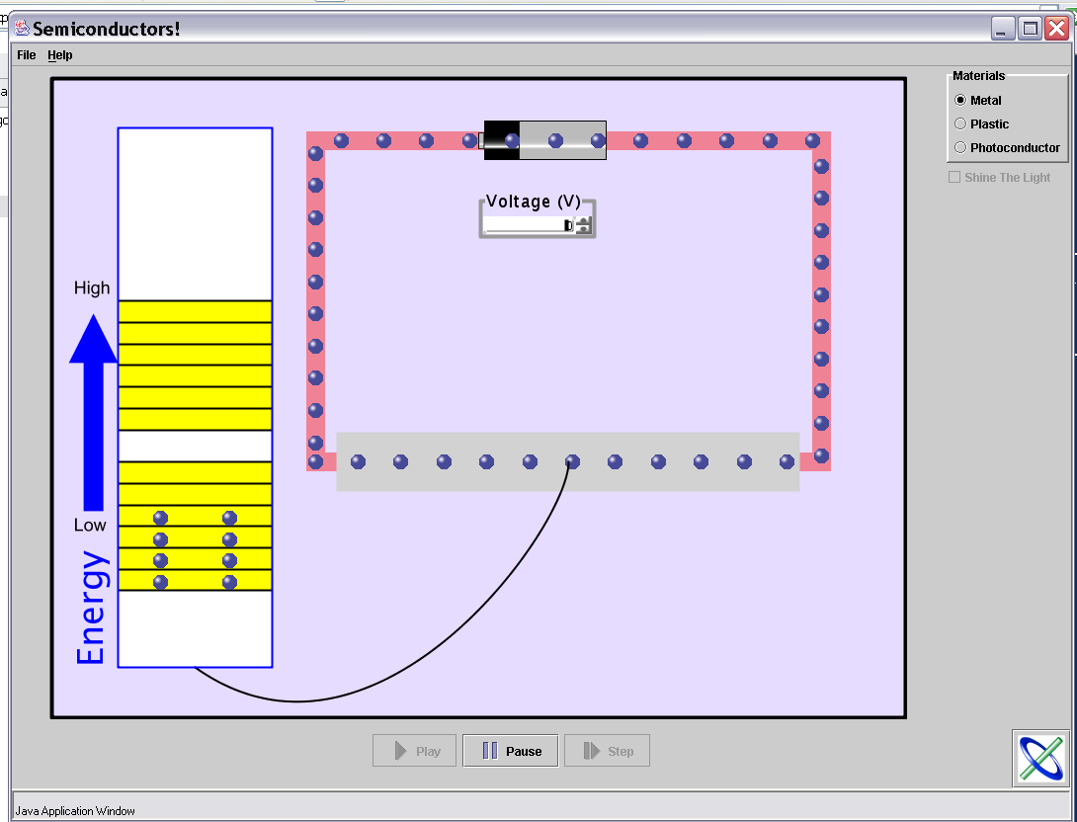
phet conductivity sim on phet site
(also semiconductor and diode sim there)

Slide 21
insulators and conductors good- wires, electricity for lights and
heating, electric motors, telegraph (I=V/R stuff).
For more interesting electrical stuff need more control-
small currents &voltages control higher powers
(“nonlinear circuit elements”).
semiconductor-- half way in between. Little gap to empty levels.
empty
how many have class on semicond?
full
sensitive enough so people can affect conductivity of material
What are possible ways could get electron to higher
empty level (out of pit), so could move to conduct electricity?
Write down on sheet of paper as many as can think of that
are practical.
One sheet per group with names of all group members here.
Will collect.

Slide 22
semiconductor-- half way in between. Little gap to empty levels, shallow
pit.
empty
full
Ways to get electron up to where can move.
1. heat
(important, but usually just as a problem- HW with numbers)
2.voltage -- can be problem and can be useful
(semiconductors that don’t conduct until enough voltage applied, then conduct well.
3. light-- photoconductors (copying machines, laser printers)
4. designer impurities- tinker slightly with energy levels. Used for all modern electronics.

