Slide 1
. Schrodinger equation and potential energy wells
Explain why a very deep square well potential is a crude but useful model for a variety of physical systems, including electrons in atoms or wires.
Calculate the possible energy levels and normalized wave functions and probability distributions for an electron in a very deep square well potential of arbitrary width in one dimension. Be able to use these distributions to predict the results of measurements of these quantities for an electron.
Explain general method for how to find allowed energies for an electron or atom in any shape potential energy well, although not carry out the detailed calculations required for obtaining values for those energies.

Slide 2
Solving the Schrodinger equation for simple model
system (square well). Easiest case of electron
confined to solve diff. equation. Form of solutions
simpler, easier to understand basic ideas of QM.
one place where this model is “reasonably” accurate
Nanotechnology: how small does an object have to be
before movement of electrons starts to depend on size
and shape due to quantum effects?

Slide 3
the 3 D Schrodinger equation for hydrogen atom,
other atoms much messier because are electron-electron
contributions to V

Slide 4
Reading quiz.
1. a. I read sections 41.3,4, 6, 7.
b. I read some, but not all of those sections.
c. I did not do the reading.
Today and Wed. -- will not make much sense if did not do the
reading. If questions on material in reading though, ASK!
2. “A particle in a rigid box in the n=2 stationary state is most
likely to be found
a. in the center of the box,
b. one third of the way from either end,
c. one quarter of the way from either end,
d. It is equally likely to be found anywhere in the box.”
1
2
c b a b c

Slide 5
reading quiz
3. In the classically forbidden region for a finite potential well, the physically meaningful solution to the Schrodinger equation is
(η is always a real positive constant)
a. a cosine function (cos(x/η) )
b. the sum of sine and cosine functions
c. an increasing exponential function( e^{+x/η} )
d. a decaying exponential function( e^{-x/η} )
e. this question makes no sense
ans. d.
ψ(x)
x
classically forbidden region,
E total less than potential energy V(x)

Slide 6
1
T = 300 K
3
T = 300 K
2
T = 300 K
E
E
E
L = 40 nm
6 x
10⁻⁴ eV
6 x
10⁻⁶ eV
L = 4 nm
0.06
eV
L = 400 nm
T = 1 K
4
5
You have to invent a “quantumticity” parameter. The value of this parameter will characterize if motion of electrons in small
blocks of metal is going to be similar to motion in large block,
or will be changed by quantum behavior. Parameter should work for all these cases, and any new case.
No single right answer. Will
have groups share their
parameters when done.
T = 1 K
E
E
6 x 10⁻⁴
eV
L = 4 nm
0.06
eV
L = 40 nm

Slide 7
Nanotechnology: how small does a wire have to be
before movement of electrons starts to depend on size
and shape due to quantum effects?
How to start?
Need to look at
a. size of wire compared to size of atom
b. size of wire compared to size of electron wave function
c. Energy level spacing compared to thermal energy, kT.
d. Energy level spacing compared to some other quantity
(what?)
e. something else (what?)

Slide 8
Nanotechnology: how small does a wire have to be
before movement of electrons starts to depend on size
and shape due to quantum effects?
How to start?
Need to look at
c. Energy level spacing compared to thermal energy, kT.
to move much have higher energy/momentum
Almost always focus on energies in QM.
Electrons, atoms, etc. hopping around with random energy kT.
Larger than spacing, spacing irrelevant. Smaller, spacing big deal.
spacing of levels in pit compared to kT?
Main parameter in behavior of solids

Slide 9
“quantumticity” parameter,
ratio of spacing between energy levels of the electron
and thermal energy kT
ΔE/kT -- small, no quantum effects-- spacing of levels
does not matter. Big-- quantum important.
ΔE=.06 eV/(L/4nm)² , kT = 0.025 eV (T/300 kelvin)
but I just made up ΔE’s for this problem.
Now we need to calculate what they really are.

Slide 10
Solving the Schrodinger equation for electron wave in 1 D
time independent
eq.
1. Figure out what V(x) is, for situation given.
2. Guess or look up functional form of solution.
3. Plug in to check if ψ’s, and all x’s drop out, leaving
equation involving only bunch of constants; showing
that trial solution is correct functional form.
4. Figure out what boundary conditions must be to make
sense physically.
5. Figure out values of constants to meet boundary conditions
and normalization
6. Multiply by time dependence Φ(t) =exp(-iEt/h)
to have full solution if needed. STILL TIME DEPENDENCE!
∞
|ψ(x)|²dx =1
-∞

Slide 11
PE
+
+
+
+
+
+
+
+
+
+
1 atom
many atoms
but lot of e’s
move around
to lowest PE
repel other electrons = potential energy near that spot higher.
as more electrons fill in, potential energy for later ones gets
flatter and flatter. For top ones, is VERY flat.

Slide 12
PE for electrons with most PE. “On top”
+ + + + + + + + + + + + + + + +
as more electrons fill in, potential energy for later ones gets
flatter and flatter. For top ones, is VERY flat.
How could you find out how deep the pit is for the top
electrons in copper wire?

Slide 13
work function of
copper = 4.7 eV
PE for electrons with most PE. “On top”
How could you find out how deep the pit is for the top
electrons in copper wire?
This is just the energy needed to remove them from the metal.
That is the work function!!

Slide 14
4.7 eV
Energy
0
L
x
0 eV
x<0, V(x) = 4.7 eV
x> L, V(x) = 4.7 eV
0<x<L, V(x) =0
0 L
x
How to solve?
a. mindless mathematician approach- find Ψ in each region,
make solutions match at boundaries, normalize.
Works, but bunch of math.

Slide 15
0 L
4.7 eV
mathematically
V(x) = 4.7 eV for x<0 and x>L
V(x) = 0 eV for 0>x<L
0 eV
b. Clever physicist approach. Reasoning to simplify how to solve.
Electron energy not much more than ~kT=0.025 eV.
Where is electron likely to be? What is chance it will be outside
of well?
a. zero chance, b. very small chance, c. small, d. likely
b. 0.025 eV<< 4.7eV. So very small chance an electron could have enough energy get out.
What does that say about boundary condition on ψ(x) ?
a. ψ(x) must be same x<0, 0<x<L, x>L,
b. ψ(x<0)~0, ψ(x>0) ≠0 c. ψ(x) ~0 except for 0<x<L
ans c. So pretty good approximation to say never gets out

Slide 16
x<0, V(x) ~ infinite
x> L, V(x) ~ infinite
0<x<L, V(x) =0
so clever physicist just has to
solve
Energy
with boundary conditions,
ψ(0)=ψ(L) =0
0
x
0
L
solution a lot like microwave & guitar string

Slide 17
A solution to this diff. eq. is
A cos(kx) and B sin (kx), so sum is also solution.
Check-- plug in.
solution if

Slide 18
makes sense, because
so condition on k is just saying that (p²)/2m = E.
V=0, so E= KE = ½ mv² = p²/2m
This result implies that the total energy of electron is
a. quantized according to E_{n} = const. x n², n= 1,2, 3, …
b. quantized according to E_{n} = const x n
c. quantized according to E_{n} = const. x 1/n²
d. quantized according to some other condition but
don’t know what it is.
e. not quantized, energy can take on any value.
e. no boundary, not quantized, energy can take on any value.

Slide 19
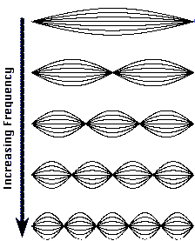
∞
∞
0 eV
0 L
functional form of solution:
Apply boundary conditions
x=0 → ?
→ A=0
x=L →
⇒?
kL=nπ (n=1,2,3,4 …)
→ k=nπ/L
2
1

Slide 20
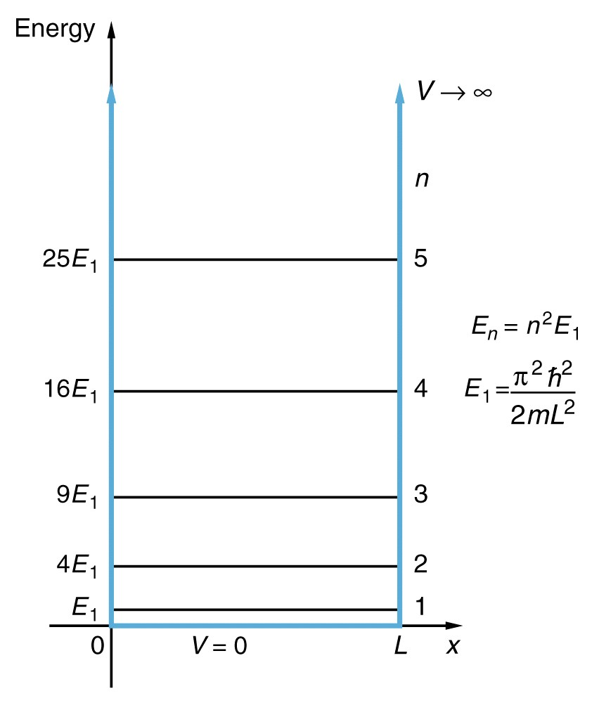
Energy quantized by boundary
conditions. Why bound electrons
have only certain discrete energies, unbound can have any energy.
Does this L dependence make sense?
leave it to you to calculate L when
ΔE = kT room temp
How many atomic diameters?
What if cooled to 1 Kelvin?

Slide 21
Solving completely-
Normalize wavefunction …
Probability of finding electron between -∞ and ∞ must be 1.

Slide 22
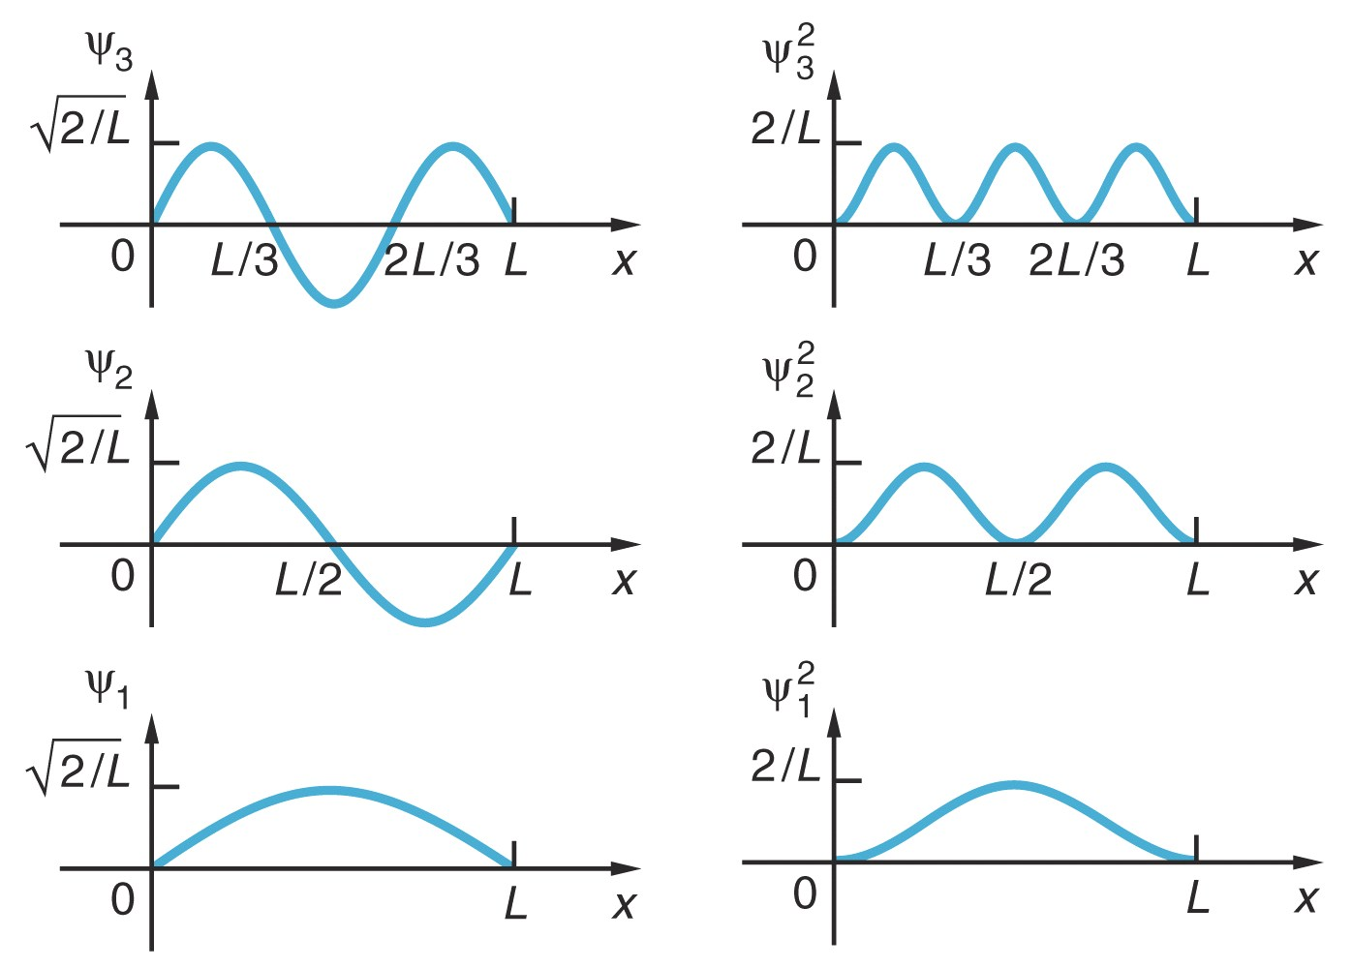
Quantized: k=nπ/L
Quantized:
energies are
“eigen values”
wave functions
“eigenfunctions”
show sim-- vary L, n

Slide 23
Quantized: k=nπ/L
Quantized:
ψ
n=2
What you expect classically:
Electron can have any energy
Electron is localized
What you get quantum mechanically:
Electron can only have specific
energies. (quantized)
Electron is delocalized
… spread out between 0 and L

Slide 24
CQ. Can electron be in combination of
n=1 and n=3?
a. yes, b. no
E
x
CQ. if went in and measured position of electron in potential
well and found it at x =2+-.01 nm, what would that mean
its energy would be?
think, then will give choices.
a. one particular discrete energy but cannot know which.
b. sum of many different energies.
c. would be impossible to do the measurement
d. the energy for which wave function had peak at that spot
e. some other answer

Slide 25
When does clever physicist model that wavefunction
never gets outside potential well fail?
(look at sim)

Slide 26
Good Approximation:
Electrons never got out of wire
ψ(x<0 or x>L) =0.
(OK when Energy << work function)
Exact Potential Energy curve:
V. small chance electrons get out of wire
ψ(x<0 or x>L)~0, but not exactly 0!
V(x)
Energy
0
x
0
L
What happens if electron Energy bigger?
What if two wires very close to each other?
Then if ψ leaks out a little or not, is very important.
How much coupling to other wire?
E_total

Slide 27
When does clever physicist model that wavefunction
never gets outside potential well fail?
(look at sim)
If energy of electron not too far below top of well, starts to
extend out a bit. (classically forbidden region)
Some special situations, VERY important. Sticks out a
bit where something important happens to it.
a. two wires close together
b. nuclear decay,
c. tunneling microscope-- see single atoms on surfaces
d. most modern electronics
e. electrons coming out of hot metal
f....

Slide 28
Detect electron position-- see it outside wire?

Slide 29
sketching how how solve for wave function for finite potential wells-- for reference if interested, not covered
in class, you are not expected to be able to do.
V. small chance electrons get out of wire
ψ(x<0 or x>L)~0, but not exactly 0!
wire
Finite
Square Well
V(x)
Energy
Workfunction
0
x
0
L

Slide 30
wire
Need to solve Schrodinger Eqn:
V(x)
4.7eV
Energy
E_{electron}
0
x
0
L
Region I
Region II
Region III
In Region II … total energy E > potential energy V
k is real
Negative number
When E>V: Solutions = sin(kx), cos(kx), e^{ikx}.
Always expect sinusoidal functions

Slide 31
wire
Need to solve Schrodinger Eqn:
V(x)
4.7eV
Energy
E_{electron}
0
x
0
L
Region I
Region II
Region III
In Region III … total energy E < potential energy V
α is real
Positive
What functional forms of ψ(x) work?
a. e^{iαx} b. sin(αx) c. e^{αx} d. more than one of these

Slide 32
wire
V(x)
4.7eV
Energy
E_{electron}
0
x
0
L
Region I
Region II
Region III
In Region III … total energy E < potential energy V
α is real
Positive
Why not e^{iαx}?
Answer is C: e^{αx} … could also be e^{-αx}.
Exponential decay or growth
LHS
RHS

Slide 33
wire
V(x)
4.7eV
Energy
E_{electron}
0
x
0
L
Region I
Region II
Region III
What will wave function in Region III look like?
What makes sense for constants A and B?
a. A must be 0 b. B must be 0 c. A and B must be equal
d. A=0 and B=0 e. A and B can be anything, need more info.

Slide 34
wire
V(x)
4.7eV
Energy
E_{electron}
0
x
0
L
Region I
Region II
Region III
What will wave function in Region III look like?
What makes sense for constants A and B?
Answer is a. A must be 0 .. otherwise ψ blows up as x gets bigger.
This doesn’t make sense!
ψ and probability should → 0 at large x!
Need to be able to normalize ψ

Slide 35
Outside well
(E<V):
(Region I)
Inside well (E>V):
(Region II)
Outside well (E<V):
(Region III)
On HW next week
4.7 eV
Energy
E_{electron}
V=0 eV
0 L
x
Boundary
Conditions:

Slide 36
Inside well (E>V):
Outside well (E<V):
4.7 eV
Energy
E_{electron}
V=0 eV
0 L
x
“Classically forbidden” region.
Electron is delocalized … spread out.
Some small part of wave is where Total energy is less than potential energy!

Slide 37
E_{electron}
0 L
wire
wire
If wire gets closer and closer, what will happen?
a. electron is “shared” between wires, with fraction in each constant over time
b. the electron will flow away through wire 2
c. electron will jump back and forth between wire 1 and wire 2
d. electron stays in wire 1.
e. something else happens.

