Slide 1
pick up midterm, end of class. How many student questions?
Davisson Germer learning goal (take too much time, optional)
Sketch out the design for an experiment to use an electron beam to measure the spacing between atoms in a clean crystal. Say what the data will look like, in quantitative terms how to extract get the atomic spacing from the data, and justify to someone who does not know QM why your data and analysis is actually measuring the atomic spacing. Suggest experiment that could verify your justification.
Next few days-- bit on modeling, then Electrons as waves goals
Given a particle description of an electron or photon, relate that to an equivalent wave description, and vice-versa.
Calculate the Broglie wavelength of a particle given the momentum, and vice-versa. Make quantitative predictions for what will be detected on screen behind two closely spaced slits when particles of known mass and energy are shot at the slits.
Describe the double-slit experiment for light and electrons and explain why the interference pattern is different depending on whether or not a measurement is made as to which slit the photon/electron passes through
Analyze the implications of the results of the double slit experiment in terms of the description of the position of an initial electron
Explain what is meant by the eigenstates of an electron, in terms of the energy, position and momentum, when the electron is both free and when it is confined in some potential energy well.
Write down the mathematical description of the wave functions for position and momentum eigenstates of free electrons.
Explain how a wave function can be used to describe a general complex superposition of all position eigenstates
Calculate the probability for finding a particle in a given region of space from its wave function.

Slide 2
Reading quiz.
1. |ψ(x)|² is
a. the number of electrons at position x
b. the probability of finding an electron at x
c. is proportional to the probability of finding electron at
x, but is not the probability itself.
2. The “normalization condition” means that
a. the probability of finding an electron in a small interval
δx must be finite.
b. the integral of ψ(x) over all x is finite.
c. the integral of ψ(x) over all x is = 1.
d. the integral of |ψ(x)|² over all x = 1.
e. the exact position of an electron is undefined

Slide 3
Reading quiz cont.
3. If the wave function ψ(x) was changed to -ψ(x) it would
a. correspond to the same pattern of where electrons would
be detected as did ψ(x).
b. correspond to a different pattern of where electrons would
be detected than did ψ(x).
c. makes no sense, since ψ(x) must always be positive.

Slide 4
Have established that electrons can show interference,
so have wavelike properties.
quantum interference sim--
light-- photon detection probability
electrons-- some kind of wave connected with electron detection probability
Model building.
Improved model of hydrogen atom. Have Bohr, have de Broglie idea, see electrons described by some kind of waves.
What is next step to make progress in improved model?
Talk to group, come up with idea, will call on groups.

Slide 5
Next step.
What is the equation that characterizes this wave.
Have to have to calculate properties, make predictions.
QM approach-- see weird stuff. Come up with equation
that might describe. Use to calculate predictions.
Test with experiments.
What equation to use for electron wave?
(obvious starting point-- look at light. De Broglie got λ=h/p right by copying light.)

Slide 6
quantum interference sim--
light-- photon detection probability
electrons-- electron detection probability
How are light waves/photons and electron waves/electrons
similar or different?
Everyone write down on sheet of paper with name on it.
List of similarities List of differences

Slide 7
similarities
differences
get interference
with λ=h/p
wave determines
probability of detecting
photon/electron
light v always =c,
electron v = v whatever
photon energy E= hf,
electron energy is
E = mv²/2 + potential energy

Slide 8
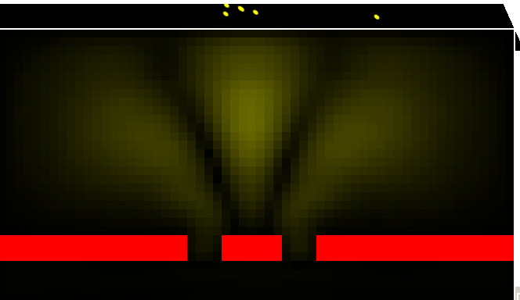
may skip
Electromagnetic wave (e.g. hitting screen of double slit)
High Amplitude
Screen
Low Amplitude
Describe photon’s EM wave spread out in space.
Probability of photon detection ~ (Amplitude of EM wave)²

Slide 9
may skip
Electromagnetic wave (e.g. hitting screen of double slit)
X-section at Screen
x
P(x)=probability density
Photon’s EM wave
Probability of photon detection ~ (Amplitude)²
x
Photons

Slide 10
Schrodinger starting point--
what do we know about classical waves (EM, violin string) and equations that describe them?
How to use or modify those wave eqs to get something
that works for electron in hydrogen?

Slide 11
try equation for EM wave, electric field ε
Works for light, why not work for electron? Wrong v, E,...
how fix-- not magic, but details not useful to you. Advanced formulation of classical mechanics ⇒ .
Each p, ⇒ partial derivative with respect to x.
Each E, ⇒ partial derivative with respect to time.
light: energy E=pc, so equal number derivatives x and t.
electron: E = p²/2m +V, so need 1 time derivative, 2 derivatives with respect to x, plus term for potential energy V.

Slide 12
so this, plus some trial and error, finally...
the Schrodinger equation for electron wave in one
dimension Ψ(x,t), with potential energy V(x)
of course for any real system, need in 3 dimensions,
⇒ just add partial derivatives of y and z, and V(x,y,z) etc.
Schrodinger wrote it down, solved for electron attached to proton, got solutions to diff. equa. that gave correct electron energy levels, L = nh/2π etc. for hydrogen atom.
trumpet fanfare

Slide 13
Not so fast...
Yes, get solutions that give particular energies and angular
momentum-- match spectroscopy of H.
Yes, see how to extend to include more electrons, ...
but, what is Ψ(x,t) ?? What does it mean physically?
How does one calculate other things from it. How is it related to other things one observes in experiments?
Many years of debate and analysis, calculations
and experimental tests.
Next few weeks of class.

Slide 14
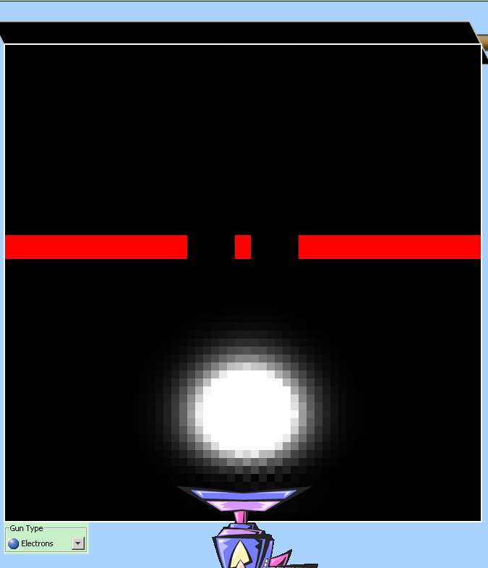
Particles are described by wave functions (Ψ)
|Ψ|² tells us probability density
Electron waves ~ waves of probability.
Electron double slit experiment.
Display=Magnitude of wave function
Large Magnitude (|Ψ|)=
probability of detecting electron here is high
Small Magnitude (|Ψ|)=
probability of detecting electron here is low

Slide 15
Matter waves:
Ψ(x,t=0)
Wave function = Ψ(x,t)
-L
L
x
Probability density = P(x,t=0) = |Ψ|² = Ψ*Ψ
what does it look like?
P(x,t=0)
Probability of electron
being in interval dx = P(x)*dx
-L
L
x
∞
P(x,t=0)dx = |Ψ(x,t=0)|²dx =1
∞
Electron must be somewhere!
-∞
-∞
Normalization condition on wave function

Slide 16
Grade distribution (observed) for 200 students
35
30
25
20
15
10
5
0
30-31.9
32-33.9
34-35.9
38-39.9
20-21.9
40-41.9
22-23.9
26-27.9
24-25.9
28-29.9
36-37.9
42-43.9
48-49.9
44-45.9
46-47.9
Probability density of grades:
prob. of finding a student in 38-40 interval?
Probability = P(x)*dx = 0.07*2 = 0.14
P(x)
0.07
What is the probability of getting a score between 38-40?
40
38
(~30/200 students)
0
20
50

Slide 17
An electron is described by the following wave function:
Ψ(x,t=0)
Ψ(x,t=0)= αx/L from -L to L
Ψ(x,t=0)=0 elsewhere
α
a
b
c
d
dx
0
x
-L
0
L
How do the probabilities of finding the electron near (within dx) of a,b,c, and d compare):
A. d>c>b>a
B. a=b=c=d
C. d>b>a>c
D. a>d>b>c
E. none of the above
Correct answer is D
P(x,t=0) = |Ψ(x,t=0)|²

Slide 18
An electron is described by the following wave function:
Ψ(x,t=0
Ψ(x,t=0)=αx/L from -L to L
Ψ(x,t=0)=0 elsewhere
α
a
b
c
d
dx
0
x
-L
0
L
How do the probabilities of finding the electron near (within dx) of a and b compare?
A. a>2b
B. a=2b
C. a<2b

Slide 19
An electron is described by the following wave function:
Ψ(x,t=0)=αx/L from 0 to L
α
P(x)
a
b
c
d
dx
0
x
-L
0
L
0
Need to look at
Probability density
P(x)= |Ψ(x,t=0)|²= α²x²
        L²
How do the probabilities of finding the electron near (within dx) of a and b
A. a>2b
B. a=2b
C. a<2b
Prob at a= P(x_{a})dx
Prob at b= P(x_{b})dx
(P(x) at a) > 2 * (P(x) at b)
Probability density is what we detect!!

Slide 20
An electron is described by the following wave function:
Ψ(x,t=0)=αx/L from 0 to L, where L = 5 nm
α
P(x)
a
b
c
d
dx
0
x
-L
0
L
0
Probability density
P(x)= |Ψ(x,t=0)|²= α²x²
        L²
the quantity α is
a. unknown, just have to get from experiment
b. we can calculate it if we had more information
c. can calculate it with the information that we have
P(x,t=0)dx = |Ψ(x,t=0)|²dx =1
∞
∞
Normalization constant
α=sqrt(3/(2L))
-∞
-∞

Slide 21
What are these waves?
EM Waves (light/photons):
Amplitude E = electric field
E² tells you probability of finding photon.
Maxwell’s Equations:
Solutions are sin/cosine waves:
Matter Waves (electrons, etc.):
Amplitude ψ = “wave function”
|ψ|² tells you probability of finding particle.
Schrodinger Equation if no V(x):
Solutions are complex sine/cosine waves:

Slide 22
at instant in time when t =0, real part is cos(kx).
Cosine wave goes from x = -∞ to x=+∞.
Electrons not spread out infinitely far. Makes no sense.
Localized electron must be sum of multiple cosine waves
with different values of k. Add up to short wiggles.
quantum interference sim.
what is happening to ψ(x) when electron detected?

Slide 23
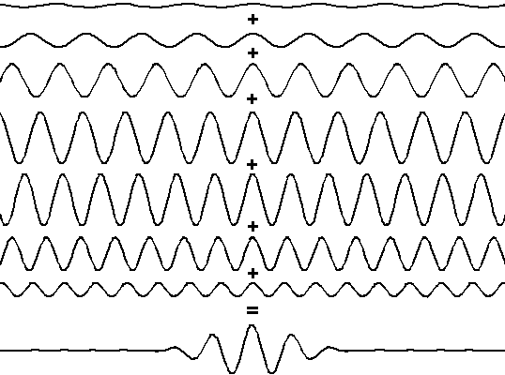
example (lots more on this in tutorial)

Slide 24
Ψ : a wave of probability
Normalization of ψ:
Integral of |ψ|² or P(x) over all space = 1
(100% likely will find electron at some x)!
Ψ(x,t=0) = 0 for x<0
ce^{-x/L} for x>=0
What is the value of normalization constant, c: such that P(x) integrated over all space =1?
a. L
b. sqrt(1/L)
c. 1/L
d. sqrt(2/L)
e. 2/L
Ψ(x,t=0)
c
0
0
L
x

Slide 25
Ψ(x,t=0) = 0 for x<0
ce^{-x/L} for x≥0
What is the value of normalization constant, c?
Particle is always somewhere in space, so |Ψ(x,t=0)|² integrated over all space must be 1!!
Ψ(x,t=0)
c
P(x,t=0)dx = |Ψ(x,t=0)|²dx =1
∞
∞
-∞
-∞
0
∞
∞
0
L
x
c²e^{-2x/L}dx = -c²L e^{-2x/L} =c²L =1 2 2
0
0
c=sqrt(2/L)
Answer = D

